Slide 1
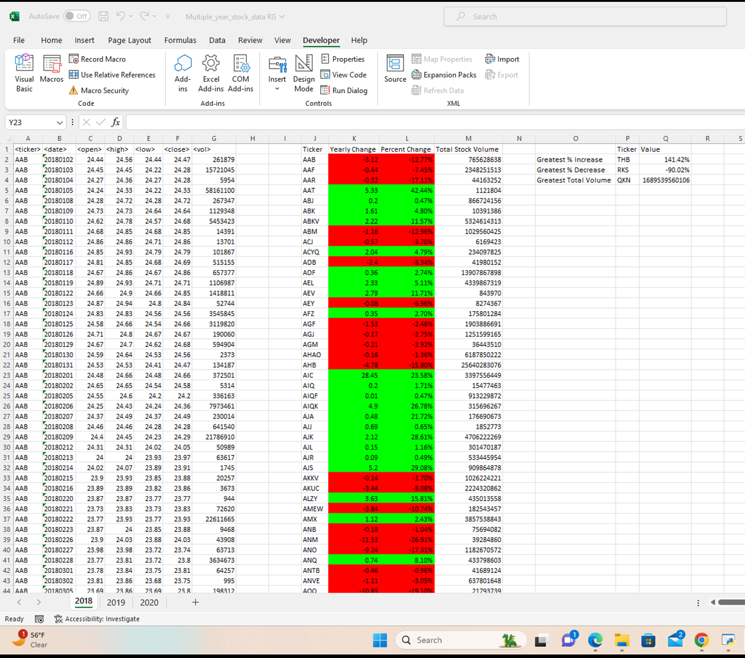
VBA Challenge
2018 Screenshot

Slide 2
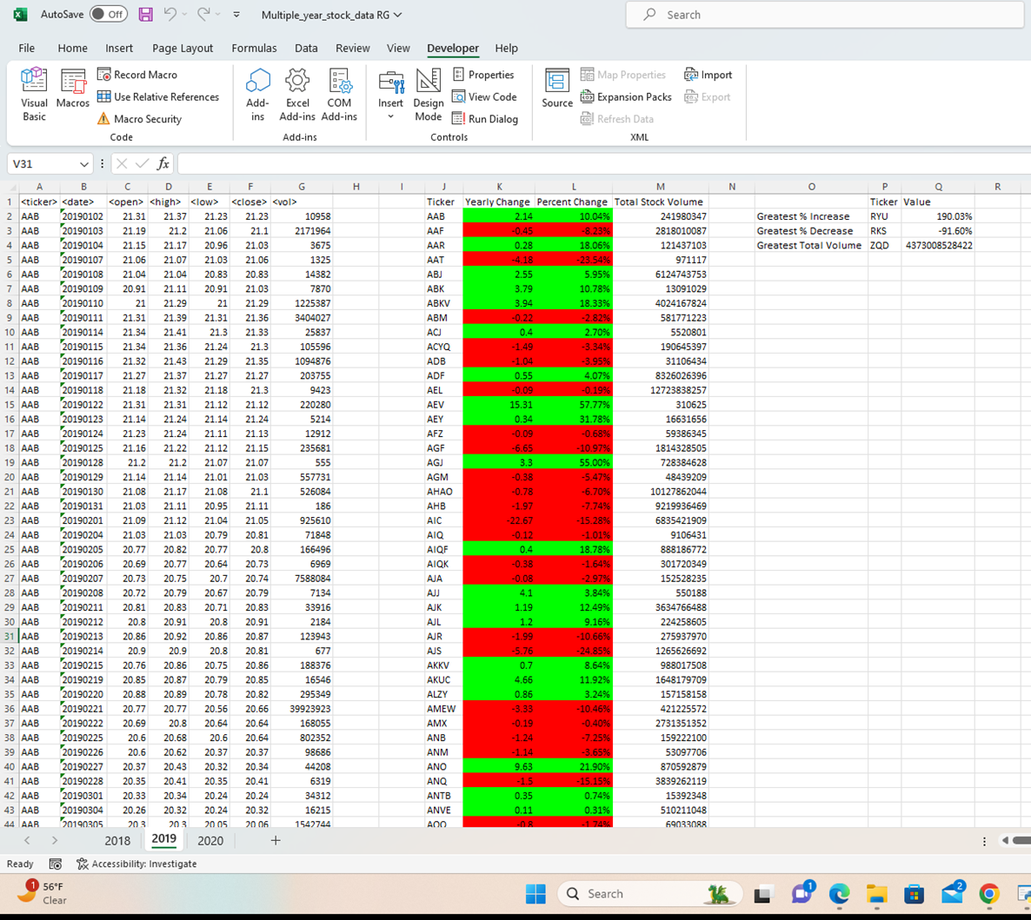
VBA Challenge
2019 Screenshot

Slide 3
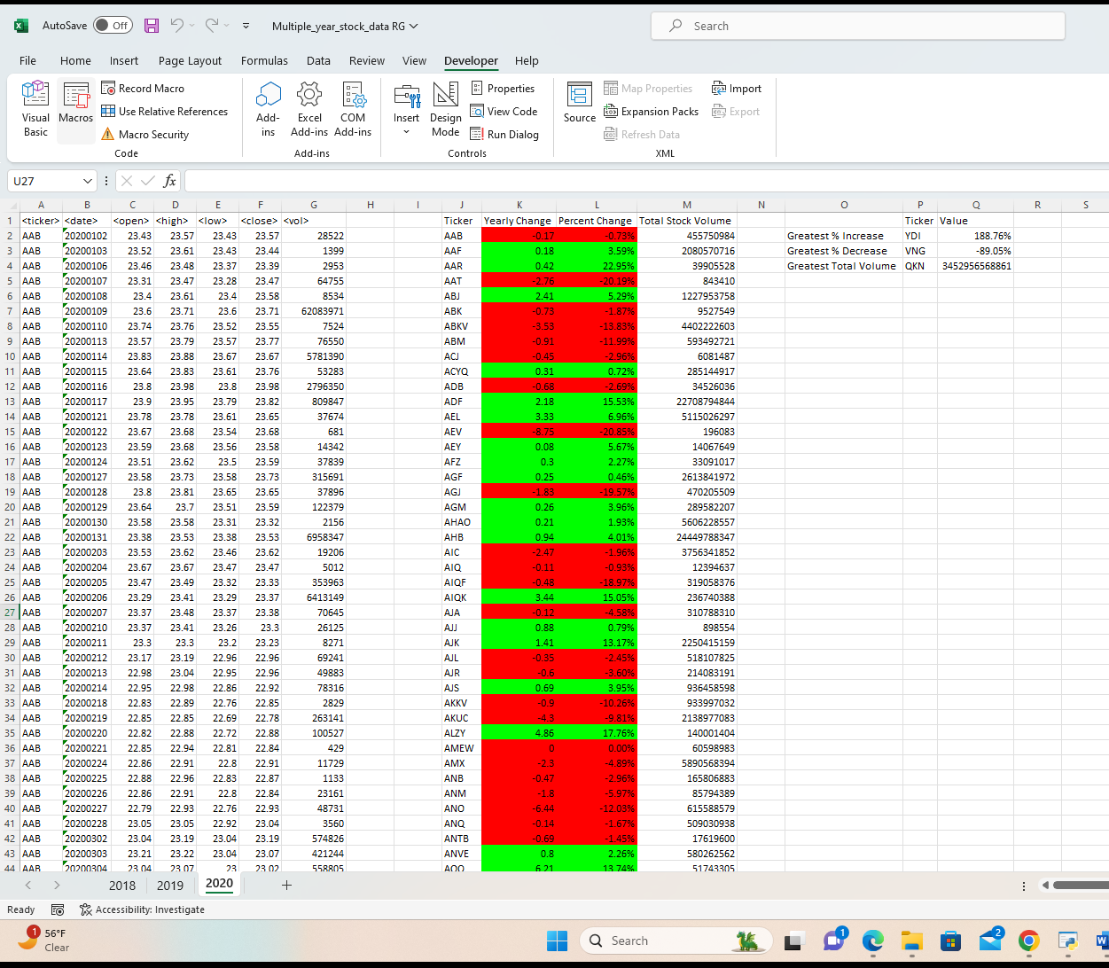
VBA Challenge
2020 Screenshot

